Slide 1
Data Factory in Microsoft Fabric

Slide 2
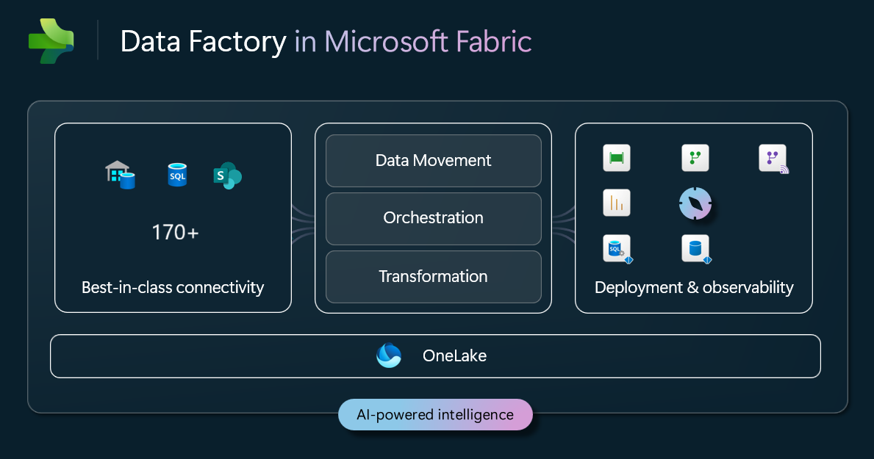
What is Data Factory in Microsoft Fabric?
Data Factory in Microsoft Fabric helps you solve one of business's toughest challenges: turning scattered data into useful insights.
Your organization's data lives in many different places: databases, files, cloud services, and legacy systems. This makes it hard to get a complete picture of your business. Data Factory connects to over 170 data sources, including multicloud environments and hybrid setups with on-premises gateways. It helps you move and transform your data at scale, turning it into formats that work well for analytics and decision-making.

Slide 3
1️⃣ Data Factory vs Azure Data Factory (ADF)
Feature | Fabric Data Factory | Azure Data Factory
Platform | Built into Fabric | Standalone Azure service
Storage | OneLake native | ADLS Gen2
Integration | Lakehouse, Warehouse | External
Billing | Fabric capacity | Pay-per-use
Governance | Purview integrated | Partial
UI | Unified Fabric UI | Separate UI

Slide 4
Fabric DF is optimized for analytics pipelines, not app integration.
“Fabric Data Factory is analytics-first and OneLake-native.”

Slide 5
2️⃣ Pipeline Concepts & Components
🔹 Core Pipeline Components
Pipeline → Orchestration container
Activities → Execution units
Parameters → Dynamic behavior
Triggers → Schedule/event-based
Variables → Runtime storage
📌 Pipelines orchestrate movement + transformation + control flow

Slide 6
3️⃣ Activity Types
🔹 A. Copy Activities
Move data between:
  On-prem → OneLake
  Cloud → OneLake
Supports batch & incremental loads
Examples:
SQL → Lakehouse
Blob → Warehouse

Slide 7
🔹 B. Transformation Activities
Dataflows Gen2
Spark notebooks
Stored procedures (Warehouse)
📌 Preferred for ELT patterns
🔹 C. Control Flow Activities
If / Switch
ForEach
Until
Wait
Fail / Set Variable
📌 Used for orchestration logic

Slide 8
4️⃣ Linked Services & Datasets (Fabric Context)
🔹 Linked Services
Connection definitions
Authentication + endpoint info
Examples:
Azure SQL
ADLS
REST API
📌 Simplified in Fabric (OneLake-aware)

Slide 9
4️⃣ Linked Services & Datasets (Fabric Context)
🔹 Datasets
Schema + location reference
Less emphasized in Fabric
Lakehouse tables act as datasets
🗣️ Trainer Line
“In Fabric, Lakehouse tables replace classic datasets.”

Slide 10
5️⃣ Integration Runtime Concepts
🔹 What is Integration Runtime (IR)?
Execution engine for pipelines.
IR Types (Fabric Context)
Managed IR (default)
On-premises IR (for local sources)
📌 No VM management required

Slide 11
6️⃣ Pipeline Design Patterns & Best Practices
🔹 Common Patterns
Ingestion → Raw → Curated
Metadata-driven pipelines
Parameterized pipelines
Reusable pipelines
🔹 Best Practices
✔ Use OneLake as landing zone
✔ Convert data to Delta early
✔ Separate ingestion & transformation
✔ Use parameters, not hardcoding
✔ Monitor via Fabric Monitoring Hub

Slide 12
End-to-End Data Factory Architecture Flow
Source Systems
↓
Linked Services
↓
Pipelines
↓
Activities
↓
OneLake (Lakehouse / Warehouse)
↓
Power BI / Analytics
“Data Factory in Microsoft Fabric provides a unified, capacity-based orchestration layer for ingesting, transforming, and managing data directly within OneLake-powered analytics workloads.”

